Slide 1
Employee Exit Surveys
Combatting Low Retention in Education
Presented by: Annetta Obichi Oleru
Updated on: May 2025
OB Optics

Slide 2
Content overview
Questions from stakeholders
Conclusion
Purpose
Appendix
Story
OB Optics

Slide 3
QUESTIONS FROM
STAKEHOLDERS
1
2
Are employees who only worked for the institute for a short period of time resigning due to some kind of dissatisfaction?
Are employees who only worked for the institute for a long period of time resigning due to some kind of dissatisfaction?
3
4
Are younger employees resigning due to some kind of dissatisfaction?
Are older employees resigning due to some kind of dissatisfaction?
OB Optics

Slide 4
90%
80%
Not only are schools struggling to hire educators, they struggle to keep them.
270,000+
86%
Purpose
Of educators cite burnout as a serious issue.
Educators QUIT the education sector every year.
Of educators are NOT SATISFIED with their job.
Source: Delvin Peck, 2025
Of public schools STRUGGLE to hire workforce.
OB Optics

Slide 5
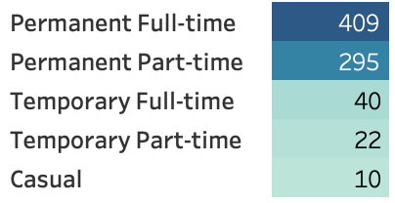
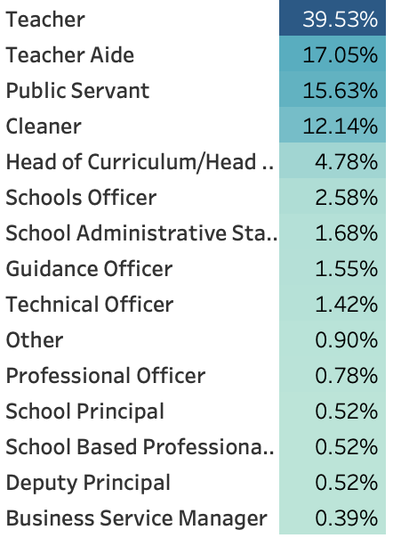
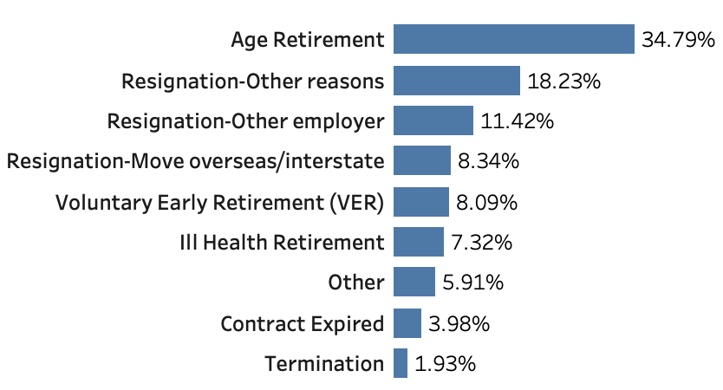
Who was surveyed?
776 Separated Staff
559 Females
220 Males
Employment Status
Employment Status
Staff Positions
Separation Type
S
For the purpose of this analysis, we will focus on retention of non- age retirement separations.
OB Optics

Slide 6
Education retention is driven by 21 themes…
Context
The exit survey data provided insight on two sections: employee satisfaction and reasons for leaving. Employees were organized into four groups to better address the business task: short-term employees, long-term employees, younger employees, and older employees.
Survey Categories:
KEPT INFORMED
MY SAY
PEER SUPPORT
PROFESSIONAL DEVELOPMENT
OPPORTUNITIES FOR PROMOTION
STAFF MORALE
WORKPLACE ISSUES
PHYSICAL ENVIRONMENT
WORK LIFE BALANCE
STRESS AND PRESSURE SUPPORT
PERFORMANCE OF SUPERVISOR
INITIATIVE
SKILLS
COACH
CAREER ASPIRATIONS
FEEDBACK
FURTHER PD
COMMUNICATION
INFORMATION
WELLNESS PROGRAMS
HEALTH & SAFETY
OB Optics

Slide 7
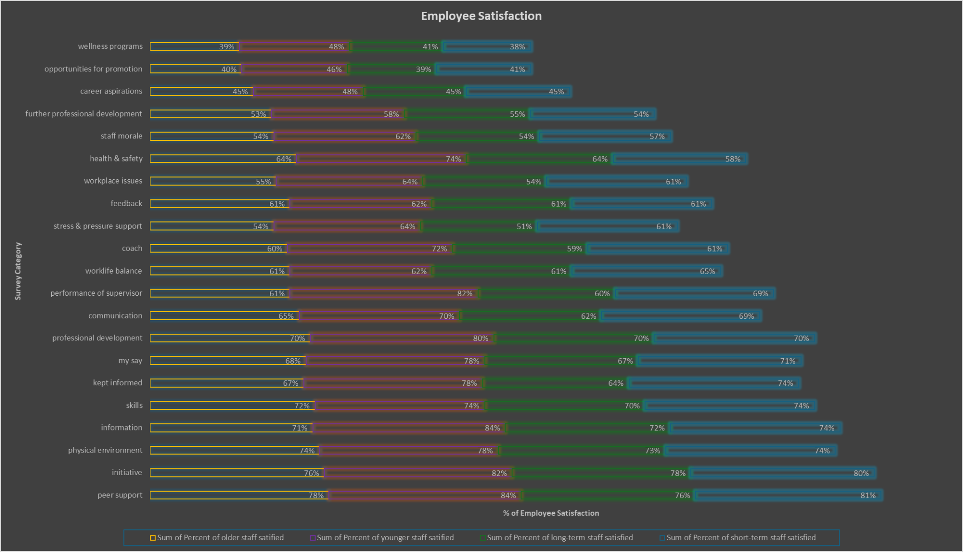
Less than 50% satisfaction
Short-term, long-term, younger, and older employees share the same areas of dissatisfaction.
Commonalities:
Wellness programs
Opportunities for promotion
Career aspirations
OB Optics

Slide 8
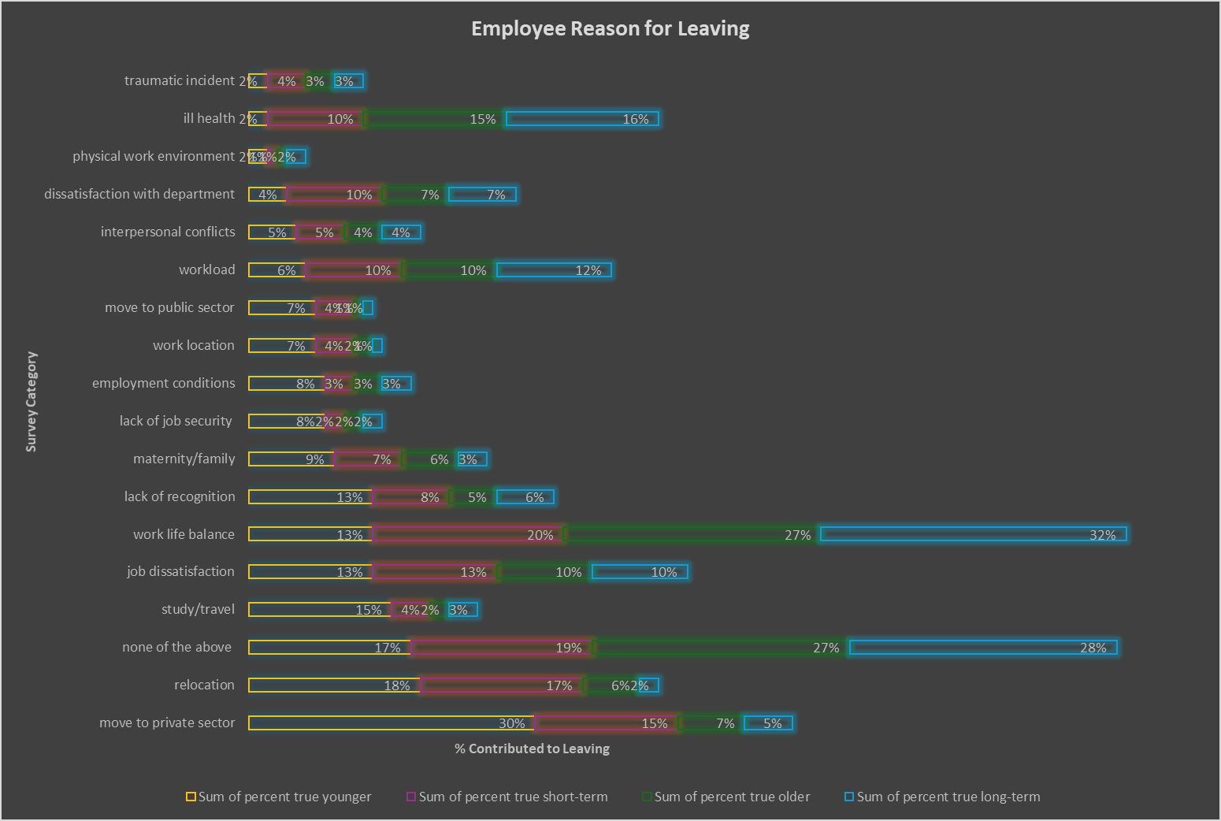
Employees reasons for leaving vary by group.
Categories are slightly different than previous section
OB Optics

Slide 9
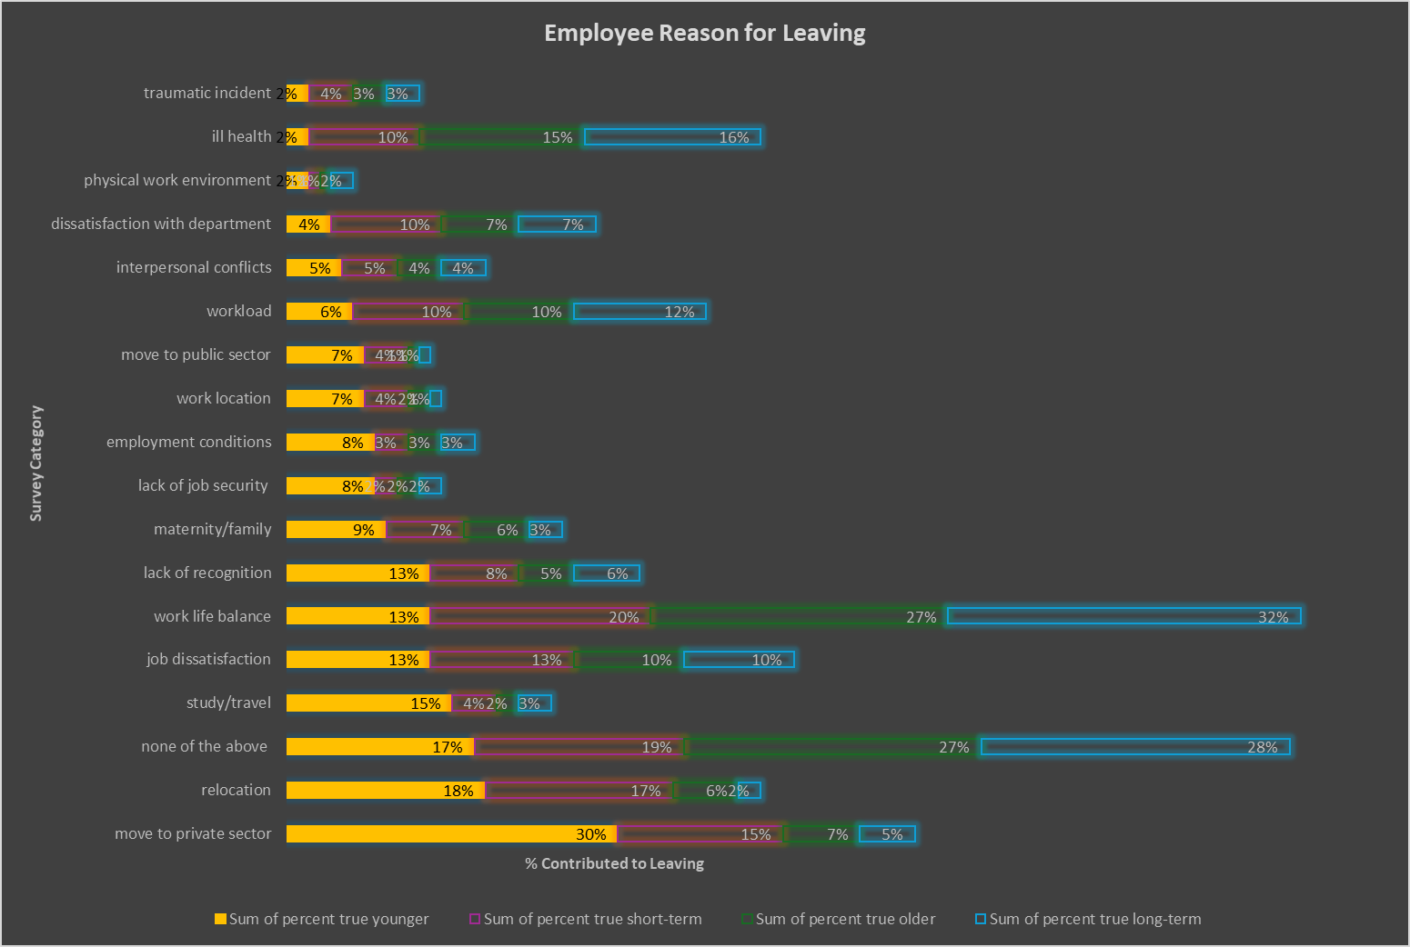
Younger employees cite:
Move to private sector
Relocation
study/travels
Reasons not listed
Reason Count:
Study/Travel
Relocation
Move to Private Sector
Other Reasons
OB Optics

Slide 10
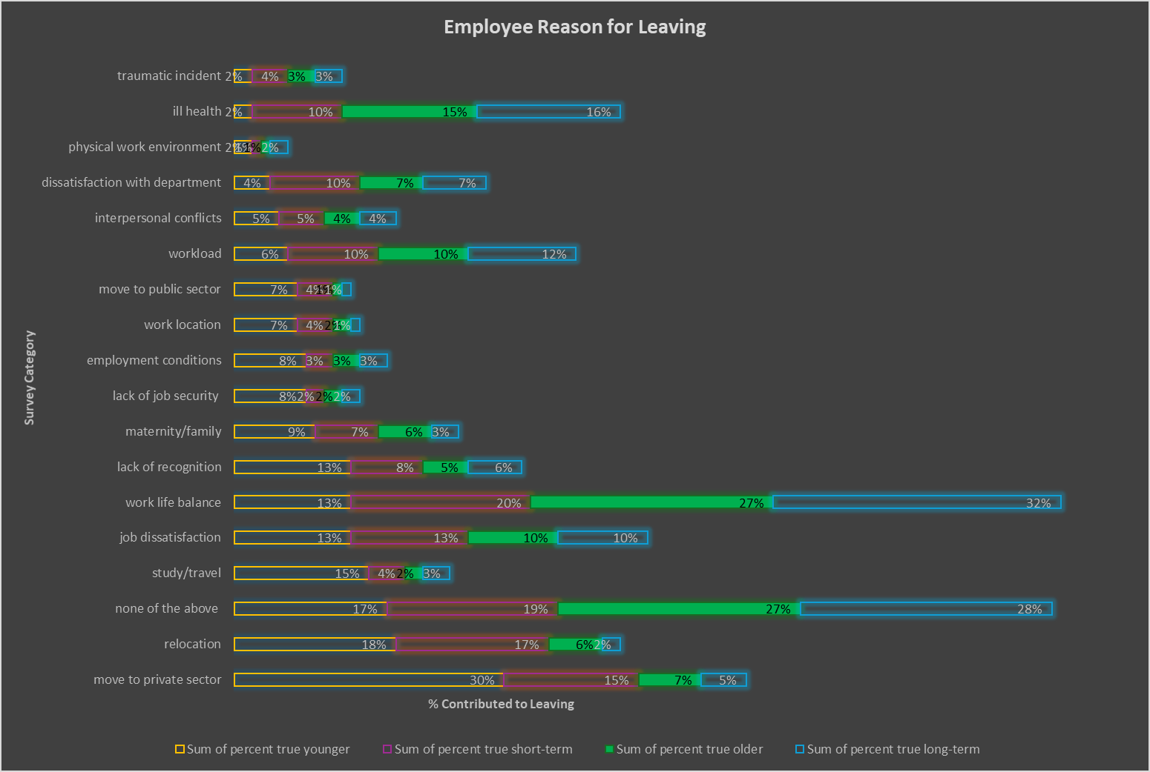
Older employees cite:
Ill health
Work life balance
Reasons not listed
Reason Count:
Study/Travel
Relocation
Move to Private Sector
Other Reasons
Ill Health
Work Life Balance
OB Optics

Slide 11
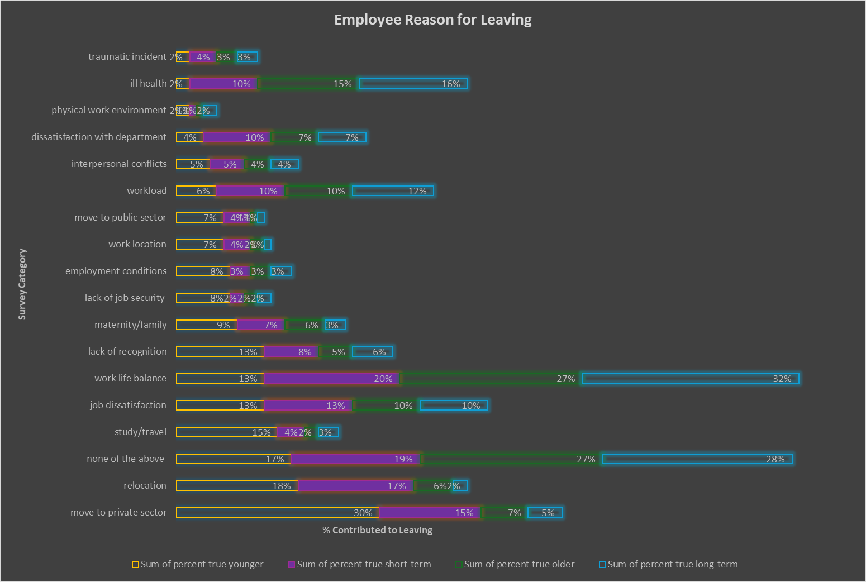
Short-term employees cite:
Work life balance
Relocation
Move to private sector
Reasons not listed
Reason Count:
Study/Travel
Relocation
Move to Private Sector
Other Reasons
Ill Health
Work Life Balance
Lack of Recognition
OB Optics

Slide 12
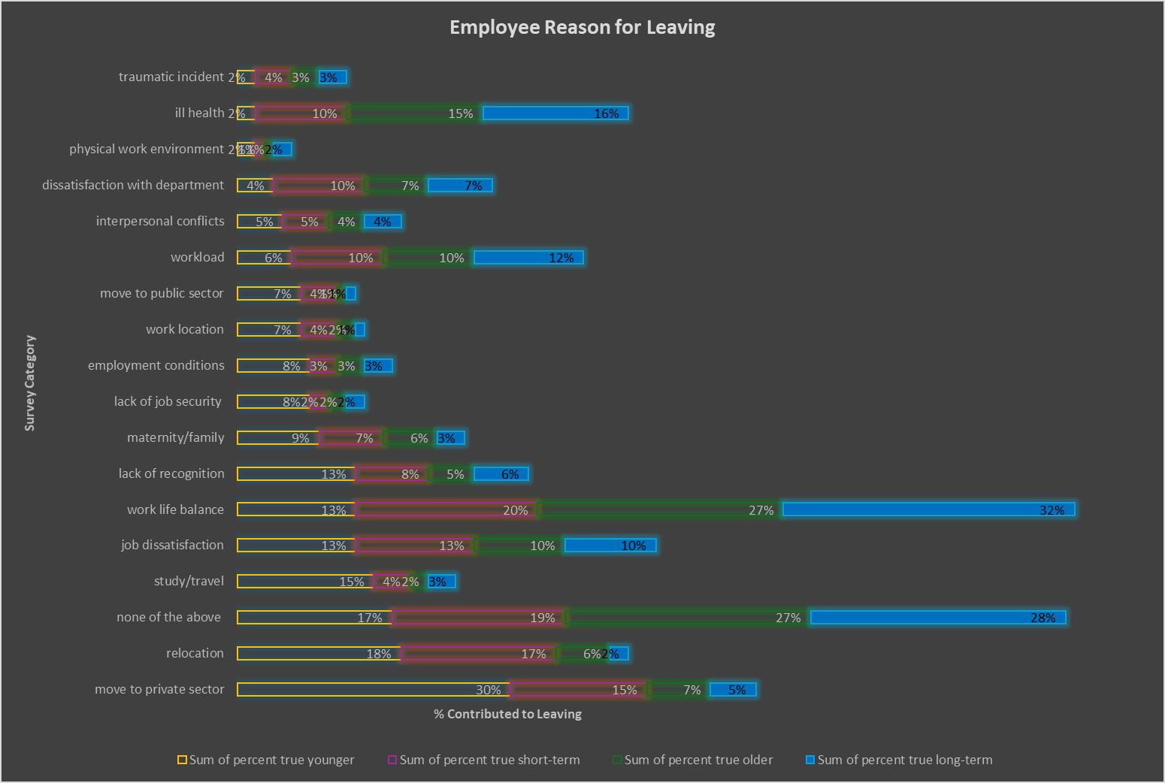
Long-term employees cite:
Ill health
Work life balance
Reasons not listed
Reason Count:
Study/Travel
Relocation
Move to Private Sector
Other Reasons
Ill Health
Work Life Balance
Lack of Recognition
OB Optics

Slide 13
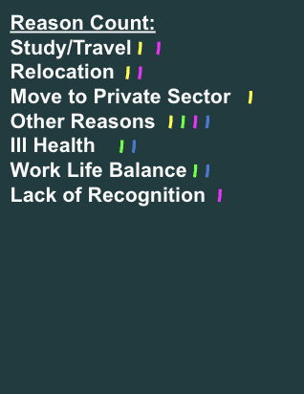
LEARNINGS
Key learning 1
Employees leaving to study/travel or relocate are not necessarily dissatisfied.
Key learning 2
Younger employees moving to private sectors are remaining in education but might want to try the private sector out of curiosity to compare the two sectors.
Key learning 3
Employees leaving due to medical concerns are not necessarily dissatisfied.
Key learning 4
Employees leaving other reasons may be personal and not related to Education.
OB Optics

Slide 14
Factors contributing to educators’ dissatisfaction require daily effort to combat and increase employee retention.
CONCLUSION
Employee Dissatisfaction
Employee Reason for Leaving
Most employees are unsatisfied with the company’s effort for career aspirations, opportunities for promotion, and wellness programs.
Short-term employees feel unrecognized as employees. Older and long-term employees struggle to balance work and personal tasks.
Career Aspirations
Opportunities for Promotion
Wellness Programs
Lack of Recognition
Work Life Balance
Recommendation 1
Recommendation 2
Recommendation 3
Give employees shoutouts at staff meetings, school assemblies, newsletters, and other public forums focusing specifically on the effort of newer employees.
Practice mindfulness during staff meetings and school assemblies as well as tips for wellness and health in newsletters.
Inquire into employees career aspirations and help them plot an actionable outline to track their progress.
Encourage employees to take advantage of opportunities for promotion as they become available.
Work life balance is a common issue among employees and cause staff to experience burnout. Encourage educators to…
Set boundaries
Practice time management
Collaborate and delegate
Invest in self-care
OB Optics

Slide 15

For more information on this analysis please visit OB Optics.
APPENDIX
Contact
Annetta Obichi Oleru
Founder of OB Optics
opticalbusinessinsights@gmail.com
https://OBOptics.github.io/Portfolio/
OB Optics

